Slide 1


Data Structures
#LifeKoKaroLift

Slide 2



Module Name - Stacks & Queues
Class - Day 6
Topic Name: Implement Stack using Queues
EditEdit MasterMaster texttext stylesstyles

Slide 3
Time Allocation Summary
Element | Slide numbers | Maximum time(min)
Spot Test | 4
Today’s Agenda | 5
Implementation of Stack using Queues | 6 - 24
Identifying Palindromic String | 25 - 27
Total Time |  | 120

Slide 4
Spot Test
Let’s take a quick revision assessment of previously taught topics :-
Introduction to Queues
Implementation of Queues

Slide 5

Today’s Agenda
Implementation of Stack using two Queues
Implementation of Stack using one Queue
Identify Palindromic String Problem

Slide 6

Implementation of Stack using Queues
Well, now you’ve learnt the basics of both stacks and queues. Here’s a challenging task for you.
Can you implement a stack using queues?
But, before let’s revise the difference between them once again.

Slide 7
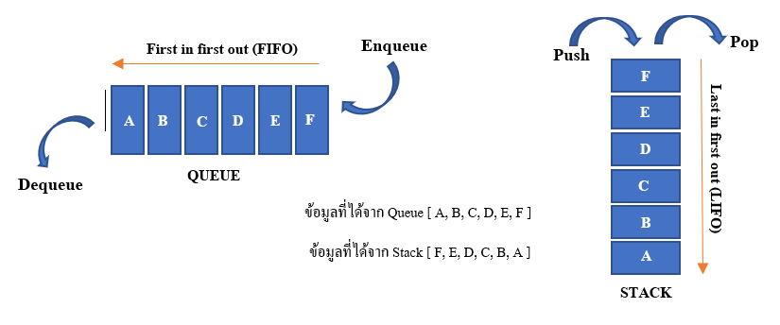
Implementation of Stack using Queues
Stacks are the data structure that follows LIFO property. Stack has a restriction that insertion and deletion can be done only at one end which is known as the 'TOP' of the stack.

Slide 8
Implementation of Stack using Queues
On the other hand, Queues are the data structure that follows FIFO property.
In queues, you can insert (enqueue) elements only at one end which is known as ‘TAIL’ and deletion (dequeue) of elements in the queue can take place at the other end which is known as ‘HEAD’.

Slide 9
Implementation of Stack using Queues
The major difference therefore is that if the elements are inserted at the same end in both these data structures, they removal takes place at different end or vice-versa.
We can therefore conclude that either the PUSH operation will be same as ENQUEUE or the POP operation will be same as DEQUEUE in our stack implemented with queues.
The former case is called implementing stack making POP operation costly and the latter is called, as you would have guessed already, implementing stack making PUSH operation costly.

Slide 10
Implementation of Stack using Queues
Let us see the implementation making POP operation costly:
The algorithm uses two queues Q1 and Q2.
The first queue Q1 will be acting as our stack, i.e PUSH and POP operations will insert and remove elements from the head of Q1.
As told already, this implementation involves assuming the heads of both stack and queue as same.
Therefore, the ENQUEUE operation does the same task as the PUSH operation and add elements to the head of Q1. Q2 is not used in PUSH.

Slide 11
Implementation of Stack using Queues
Let’s see a visual demonstration to understand the PUSH operation’s execution:
PUSH 1: 1 is enqueued to Q1. The head of the Q1 becomes the head of the stack.
PUSH 5: 5 is enqueued to Q1.
PUSH 3: 3 is enqueued to Q1.
1
5 | 1
3 | 5 | 1

Slide 12
Implementation of Stack using Queues
Here is the flow of the implementation of the costly POP operation:
The POP operation will be performed using both queues Q1 and Q2.
All the elements except the last one( the element to be popped) will be dequeued one by one from Q1 and enqueued into the Q2.
The remaining element from Q1 is dequeued and returned after the names of Q1 and Q2 are swapped.
Let’s perform the pop operation on this stack from our last slide:
3 | 5 | 1

Slide 13
Implementation of Stack using Queues
Q1: Q2:
STEP 1: Dequeue all the elements except last from Q1 and enqueue them to Q2.
Q1: Q2:
Q1: Q2:
STEP 2: Dequeue the last element from Q1 and return it.
Q1: Return 3; Q2:
STEP 3: Swap Q1 and Q2.
Q2: Q1:
3 | 5 | 1
3 | 5
1
3
5 | 1
5 | 1
5 | 1

Slide 14
Implementation of Stack using Queues
Let’s test your newly learnt knowledge now...
What will be the output after the following commands are executed?
PUSH(1)
PUSH(2)
PUSH(3)
POP
PUSH(1), (2) and (3) will enqueue 1, 2 and 3 into Q1.
What about the POP operation now? Will it be simple?

Slide 15
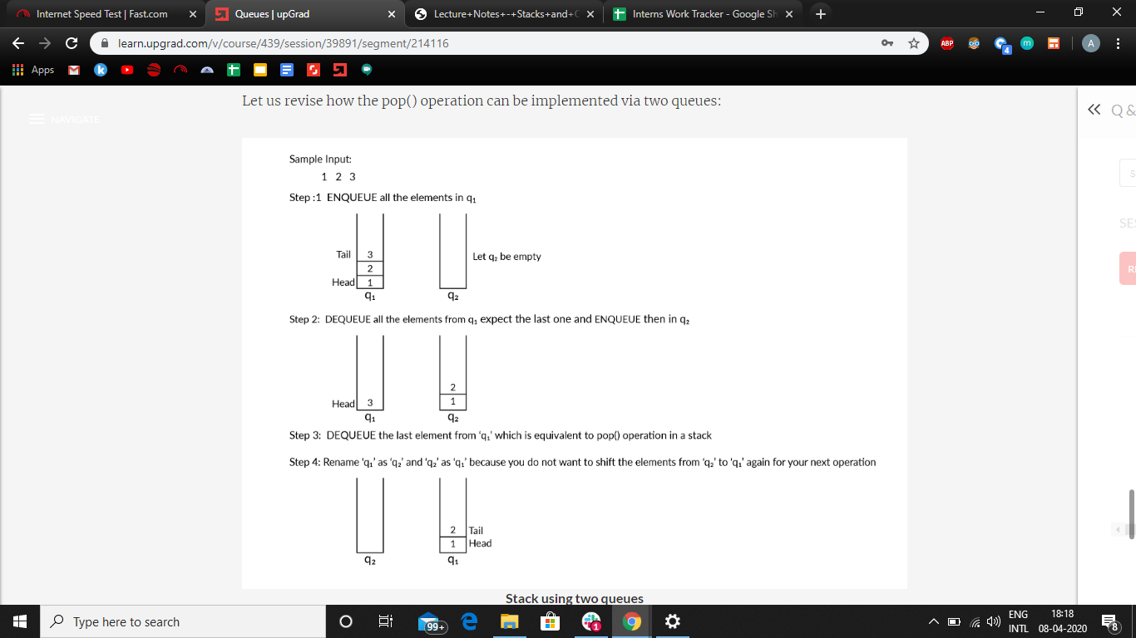
Implementation of Stack using Queues
For the POP operation:

Slide 16
Implementation of Stack using Queues
For the POP operation:

Slide 17
Implementation of Stack using Queues

Slide 18
Implementation of Stack using Queues
Let’s quickly check the algorithm if we implement the stack making PUSH operation costly:
The POP operation in this case will simply be a dequeue from our queue Q1.
For the PUSH operation, the steps will be:
Enqueue the element to be pushed in Q2.
Dequeue all the elements from Q1 one by one and enqueue them to Q2.
Swap the names of Q1 and Q2

Slide 19

Implementation of Stack using Queues
Well, that was the implementation of a stack using two queues.
Do you think it is possible to implement a stack using only queue?
YES!!! It is possible. Let’s check how.

Slide 20
Implementation of Stack using Queues
To implement a stack using a single queue, we basically need to solve the purpose of the other queue we used to implement the stack using two queues.
We assigned either ENQUEUE or DEQUEUE operation as PUSH or POP and used the second queue to implement the remaining function.
This was because if the elements in both queue and stack are added/ removed from same end, they are removed/added to different ends.

Slide 21
Implementation of Stack using Queues
So our new objective is to manipulate our queue such that if the element is added at one end, it reaches the opposite end before the next operation. Let’s see our new PUSH and POP functions now:
PUSH(x)
Calculate size(S) of the queue Q.
Enqueue x to Q
One by one Dequeue s items from Q and enqueue them back.
POP
Dequeue an item from Q

Slide 22
Implementation of Stack using Queues
Let’s understand with the help of an example:
Assume that our queue already has elements 1, 2, 3 in it and now we want want to PUSH 4 into our stack.
Step 1 will be to calculate the size of the stack/queue which will be equal to 3 here.
Now we enqueue 4 to our queue. The queue now becomes 1, 2, 3, 4.
Now we dequeue from the queue and enqueue the element i.e. 1 back to the queue. The queue now becomes 2, 3, 4, 1.
We repeat the same step 3(size) times. Finally the queue becomes 4, 1, 2, 3.

Slide 23
Implementation of Stack using Queues
The following illustration will help you understand the concept better:
Queue: Head Tail Size = 3 Next operation: PUSH 4
3 | 2 | 1
Enqueue 4
Dequeue 1
3 | 2 | 1
4 | 3 | 2 | 1
1 | 4 | 3 | 2
Enqueue 1
Dequeue 2
Enqueue 2
Dequeue 3
3 | 2 | 1 | 4
2 | 1 | 4 | 3
Enqueue 3

Slide 24
Implementation of Stack using Queues
Well let’s see the java implementation of the same now:
void push(int x){
int size = q.size();
q.add(x);
for (int i = 0; i < size; i++){
int temp= q.remove();
q.add(temp); }}
int pop(){
if (q.isEmpty()) {
System.out.println("Stack is empty");
System.exit(0); }
int x = q.remove();
return x; }

Slide 25
Identify a Palindromic String
Well here’s the last problem of the topics and it’s a problem you already are familiar with.
Just to revise, a palindrome is a word, string, phrase or sentence that reads same backward as forward. For example, “MALAYALAM”, “LEVEL” etc.
As queues and stacks are one of the most frequently used data structures for storing and modifying information, we need to devise an algorithm to check whether the characters of the input string forms a palindrome or not using either stacks or queues.

Slide 26
Identify a Palindromic String
Let’s see the steps of the algorithm to help us check the palindromic nature of a stack.
Use a ‘for’ loop to push each character of the string into an array stack.
Initialise an empty string say “reversedString”.
pop() the characters from the stack one by one and add it to the reversedString.
Compare the input string and the reversed string. If they are equal, then print “The input String is a palindrome”.
If they are not equal, then print “The input String is not a palindrome”.

Slide 27
Identify a Palindromic String
Will the time complexity of our algorithm be O(n) or O(n²)???
The space complexity of the discussed approach is O(n²) due to the variable string used.
Strings are immutable in Java; therefore, a new string of length ‘n’ will be created ‘n’ times.
To avoid creating a new string everytime you add a character, you can use StringBuilder class in Java.
The strings created using StringBuilder class are modifiable and do not need any repetitive creation.
Therefore, the space complexity is reduced to O(n).

Slide 28
Thank You!
#LifeKoKaroLift

